Slide 1
September STEM Symposium
Mini Jet Lab Part 4 Data Sharing & Analysis

Slide 2
Learning Objectives:
To understand and apply the ‘scientific method’:
Share and collect data.
To analyze various forms of data.
To draw meaningful conclusions from the data.

Slide 3
Data Sharing & Analysis
There are many different metrics (types of data) that you have recorded and once you have collected the data for the whole class you will be able to compare your plane’s overall performance; however, there is more than one way that you might rank your plane. For instance, did you plane fly the furthest, was it the most accurate, or was it the fastest?
你已经记录了多种不同类型的数据，当收集完整个班级的数据后，就可以进行小组飞机整体性能的比较了；当然，有多种方式可以对飞机进行排名。例如，谁的飞机飞得最远？谁的飞机飞得最直？谁的飞机飞得最快？

Slide 4
Data Sharing & Analysis
Data Metrics数据类型
‘Displacement’ is the measurement of the distance the plane flew towards it’s intended target. Therefore, a higher ‘displacement’ value is preferable. “位移”是指飞机飞向预定目标的距离。因此，“位移”越高越好。
‘Deviation’ is the measurement of how far the plane went off course. A plane with no ‘deviation’ is more accurate than a plane with a higher ‘deviation’ value. Therefore, a plane with a ‘deviation’ of ‘0.0m’ would be the most accurate plane. “偏差”是指飞机偏离航线的程度。没有“偏差”的平面比“偏差”值较高的平面更准确。因此，“偏差” 为“0.0米”的飞机将是最准确的飞行飞机。

Slide 5
Data Sharing & Analysis
Data Metrics数据类型
Actual ‘distance’ flown is the measurement of how far the plane flew in total. This value is slightly different from ‘displacement’ as it combines the displacement value with how far a plane flies off course. 实际飞行的“距离”是衡量飞机总共飞行了多远。这个值可能与“位移”略有不同，“距离”包括了飞机飞行的所有路程。
‘Speed’ is the measurement of how fast a plane is. Ideally, passengers prefer faster planes. Therefore, engineers are always looking at ways to make planes faster and more efficient. “速度”是衡量飞机飞行速度的指标。理想情况下，乘客偏爱更快的飞机。因此，工程师们总是在寻找使飞机更快、更高效的方法。

Slide 6
Data Sharing & Analysis
Data Sharing 数据共享
Each group will take turns to write their groups’ data on the whiteboard at the front of the class. After every group is done you can neatly copy all the results to the table below. Make sure to clearly indicate which results belong to your group by using highlighter. 首先每小组在教室前面的白板上写下各小组数据。然后，把其他小组分享的数据整齐得添加到下表中。最后，用荧光笔清楚地表明你本小组的数据。

Slide 7
 | Time 时间（s） | Displacement 位移（m） | Deviation 偏差（m） | Distance 距离（m） | Speed 速度（m/s）
Group #1
Group #2
Group #3
Group #4
Group #5
Group #6
Group #7
Group #8
Group #9
Group #10

Slide 8
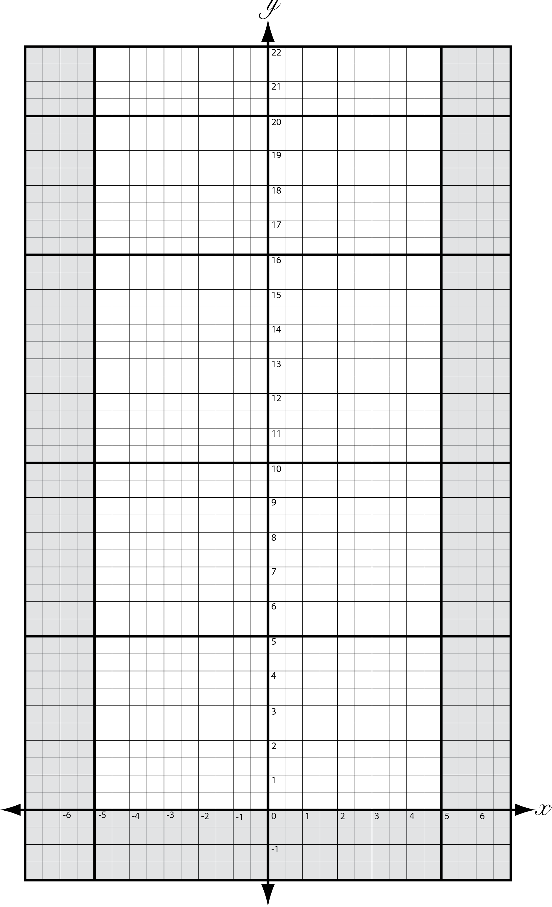
Data Sharing & Analysis
Once you have all the data recorded, plot the flight data on the provided ‘Cartesian Plane’. Use blue or black to indicate the data from other groups. Use a different color such as red to plot your groups results so that it stands out. 记录完所有数据后，在提供的“笛卡尔平面”上绘制每组平均飞行数据。使用蓝色或黑色表示其他组的数据，同时使用不同的颜色（如红色）绘制本组的数据。

Slide 9
Data Sharing & Analysis
Data Analysis 数据分析
Identify which groups plane was the best for each of the various metrics that have been indicated. Then compare your plane to the plane that you have just identified. Finally, compare your groups plane to the class average (i.e., group __ had the fastest plane. It flew at a speed of __m/s whereas our plane flew __m/s; however, while our plane was not as fast as group __ plane, it was __m/s faster than the class average).
确定出在每种不同的数据类型下哪一组的飞机是最好的。然后将你们组的飞机与其进行比较。最后，将你们组的飞机与班级平均水平进行比较（即，第__组的飞机速度最快。它的飞行速度为__m/s，而我们的飞机飞行速度是__m/s；虽然我们的飞机没有第__组飞机快，但它比班级平均水平快__m/s）。

Slide 10
Data Sharing & Analysis
Which group had the plane that flew for the longest amount of time? 哪一组的飞机飞行时间间隔最长？
Which group had the greatest average ‘displacement’ value? 哪一组的飞机平均“位移” 值最大？
Which group had the smallest average ‘deviation’ value? 哪一组的飞机平均“偏差”值最小？
Which group had the plane that flew the greatest ‘distance’? 哪一组的飞机飞行“距离”最大？
Which group had the plane that flew the fastest? 哪一组的飞机飞得最快？

