Slide 1
September STEM Symposium
Mini Jet Lab Part 3 Data Collection Methods

Slide 2
Learning Objectives:
To understand and apply the ‘scientific method’:
To follow the lab procedures that have been developed by each group (i.e., to utilize assigned roles and testing methods);
To generate consistent and reliable data / results (i.e., to conduct a controlled experiment);
To collect and review data from an experiment.

Slide 3
Data Collection Methods
Please indicate which group member completed each of the following tasks during your experiment (please note that one person may be responsible for more than one role).
请说明在实验期间完成以下每项任务的小组成员（请注意：一个人可能担任多个角色）。
‘Qualitative Observations’ recorded by: ____________________ “定性观察”记录人:
‘Quantitative Observations’ recorded by: ____________________ “定量观察”记录人：
Who measured the distance for each flight? ____________________ 谁测量每次飞行的距离？
Who operated the stopwatch? ____________________ 谁操作秒表？
Tester (i.e., who threw the plane for each test flight): ____________________ 测试人（即每次试飞投掷飞机的人

Slide 4
Data Collection Methods
Special Notes 特别说明
‘Qualitative Observations’ would include visual observations about each test flight. “定性观察”将包括每次试飞的视觉观察。
The ‘Tester’ should always remain the same throughout the entire experiment and should always use the same method and strength to throw the plane each time. 在整个实验过程中，“测试人”需始终保持不变，每次都应该使用相同的方法投掷飞机。

Slide 5
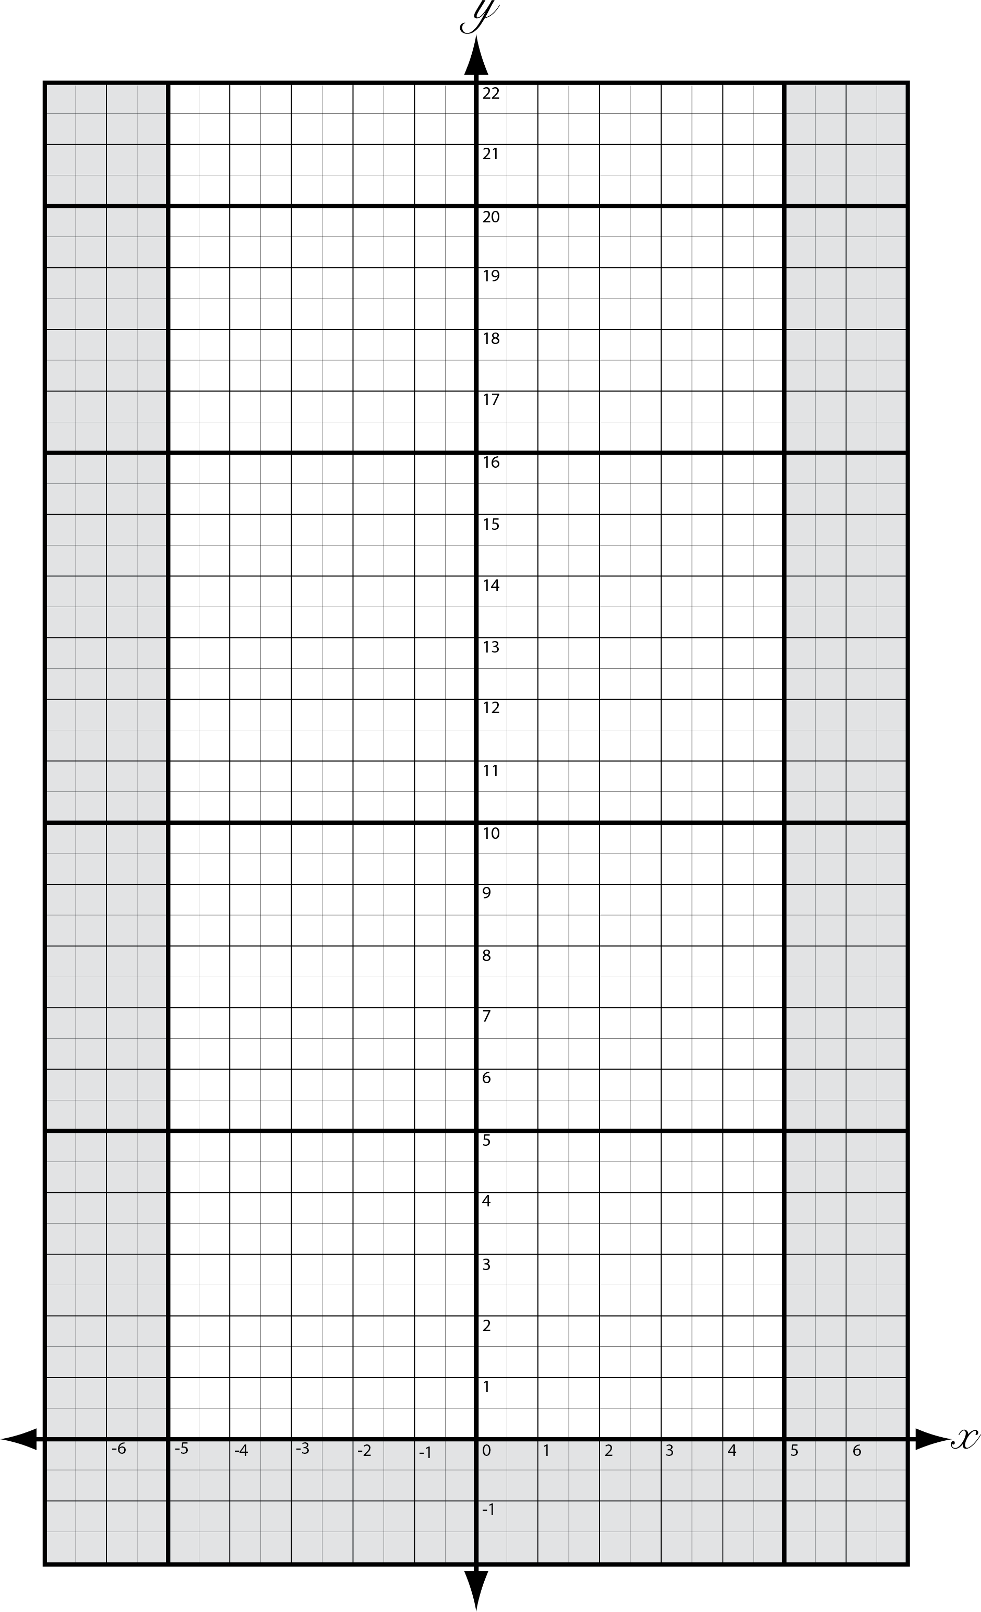
Mini Jet Data Collection
During The Experiment实验中
Start at the ‘origin’ (position 0,0) and throw your plane in a straight line. Start by recording how long your plane was in motion (from the time it left your hands to it when stopped moving).
从“原点”（位置0,0）开始直线投掷飞机，并记录飞机运动的时间（从它离手到停止运动的那一刻）。

Slide 6
Mini Jet Data Collection
Then record the position of each test flight on the data on the ‘Cartesian plane’ followed by the numerical values for the ‘X-axis’, and ‘Y-axis’ in the chart below. Then calculate the ‘minimum’, ‘maximum’, and ‘average’ values.
然后将每次试飞的位置记录在“笛卡尔平面” 上的数据上，即下面数据图中“X轴”和“Y轴”的数值。完成后，计算“最小值”、“最大值”和“平均值”。
⦿Test #3
(1.3, 18.2)
⦿Test #1
(-3.6, 17.4)
⦿Test #2
(2, 13.5)

Slide 7
Mini Jet Data Collection
Quantitative Data 定量数据
 | Time (s) 时间（s） | Displacement Y-axis (m) 位移y轴（m） | Deviation X-axis (m) x轴偏差（m）
Test Flight #1 试飞#1
Test Flight #2 试飞#2
Test Flight #3 试飞#3
Test Flight #4 试飞#4
Test Flight #5 试飞#5
Minimum 最小值
Maximum 最大值
Average 平均值

Slide 8
Mini Jet Data Collection
Qualitative Data 定性数据
Record visuals observations for each test flight. Did the plane fly in a straight line, did it crash into something while it was in the air, did it break mid-flight, etc. 记录每次试飞的视觉观察结果。飞机是否直线飞行，是否在空中撞到什么东西，是否在飞行途中断裂等等。
____________________________________________________________________________________
____________________________________________________________________________________
____________________________________________________________________________________
____________________________________________________________________________________
____________________________________________________________________________________

Slide 9
Mini Jet Data Collection
After The Experiment 实验后
You will now need to calculate the actual ‘distance’ flown and the speed of your plane. To do this you will need to use some math to calculate the actual distance flown.
现在需要运用一些数学来计算飞机的实际飞行距离和速度。
Correction in Chinese needed

Slide 10
Mini Jet Data Collection
Using the values for ‘displacement’ (e.g., the distance traveled towards the target), and ‘deviation’ (e.g., the distance the plane went off course) you can calculate the total ‘distance’ flown. Then using the value for ‘distance’ and ‘time’, you can calculate the ‘speed’ of your mini jet.
使用 “位移”（例如，飞向目标的距离）和“偏差”（例如飞机偏离航线的距离）的值，可以计算飞行的总距离。然后用这个值可以计算出飞机的速度。

Slide 11
Mini Jet Data Collection
To calculate the actual ‘distance’ flown, you can use ‘Pythagoreans theorem’ (i.e., $a^{2}+b^{2}=c^{2}$) where ‘a’ is equal to the ‘displacement’, ‘b’ is equal to the ‘deviation’, and ‘c’ is equal to the total ‘distance’ flown.
要计算实际飞行的“距离”，可以使用“勾股定理”（即, $a^{2}+b^{2}=c^{2}$），其中“a”等于“位移”，“b”等于“偏差”，“c”等于飞行的总“距离”。

Slide 12
Mini Jet Data Collection
To calculate the actual ‘distance’ flown, you can use ‘Pythagoreans theorem’ (i.e., $a^{2}+b^{2}=c^{2}$) where ‘a’ is equal to the ‘displacement’, ‘b’ is equal to the ‘deviation’, and ‘c’ is equal to the total ‘distance’ flown.
要计算实际飞行的“距离”，可以使用“勾股定理”（即, $a^{2}+b^{2}=c^{2}$），其中“a”等于“位移”，“b”等于“偏差”，“c”等于飞行的总“距离”。
$$a^{2}+b^{2}=c^{2}$$
∴ the total ‘distance’ flown by the ‘mini jet’ is equal to 17.76m.
$${−3.6}^{2}+{17.4}^{2}=c^{2}$$
$$\left(−3.6\right)∗\left(−3.6\right)+\left(17.4\right)∗\left(17.4\right)=c^{2}$$
∴“迷你飞机”飞行的总“距离”等于17.76m。
$$12.96+302.76=c^{2}$$
$$315.72=c^{2}$$
$$\sqrt{315.72}=c$$
$$17.76m=c$$

Slide 13
Mini Jet Data Collection
Or you can use trigonometry where ‘side b’ represents ‘displacement’, and ‘side a’ is represents the ‘deviation’. You can then use these values to calculate the measurement of ‘angle A’ and then solve for ‘side c’ which is the actual ‘distance’ flown by your plane.
或者可以使用三角法，其中边“b”是“位移”，边“a”是“偏差”，然后，用这些值来计算“角度A”的值，再求解“侧面c”，即飞机飞行的实际“距离”。

Slide 14
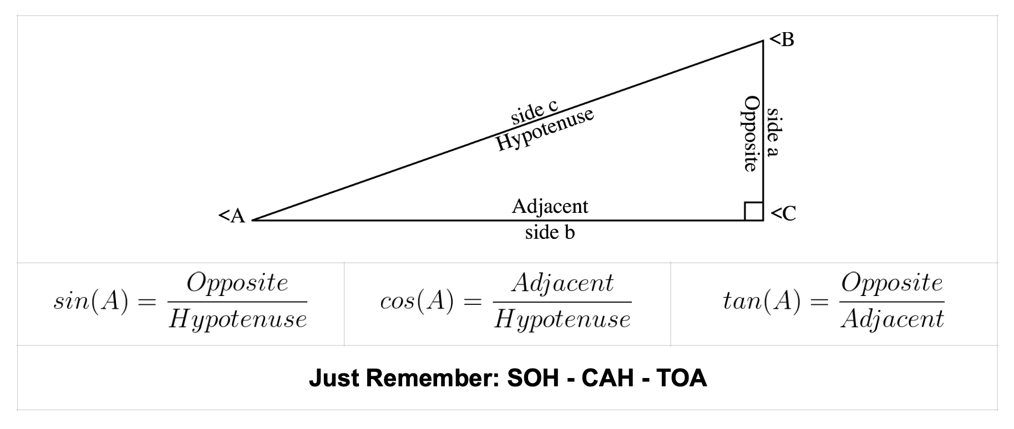
Mini Jet Data Collection
Use the refence below to help.
可参考下面的资料。

Slide 15
Mini Jet Data Collection
Calculations 计算
 | Displacement (m) 位移（m） | Deviation (m) 偏差（m） | Distance (m) 距离（m） | Speed (m/s) 速度（m/s）
Minimum 最小值
Maximum 最大值
Average 平均值

